Slide 1
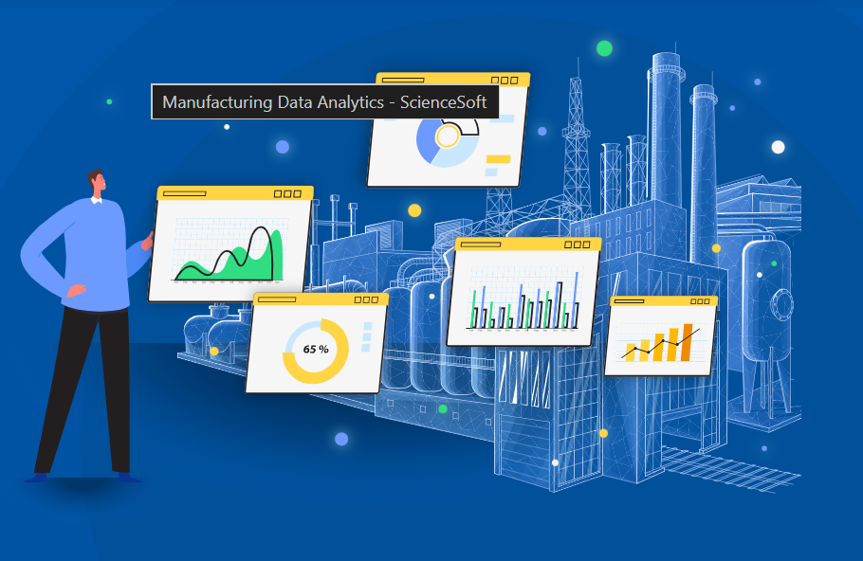
Manufacturing Data

Slide 2

Project Overview
Manufacturing data helps organizations monitor production activities, identify inefficiencies, and improve operational performance. By analyzing this data, companies can make better decisions to increase productivity, reduce waste, and maintain product quality.
The goal is to provide real time insights and support data-driven decision-making

Slide 3
Key Performance Indicators (KPI’s) Manufacturing Dashboard KPI
Manufacture Qty
Rejected Qty.
Processed Qty
Wastage Qty
Employee Wise Rejected Qty
Machine Wise Rejected Qty
Production Comparison Trend.
Manufacture Vs Rejected
Department Wise Manufacture Vs Rejected

Slide 4
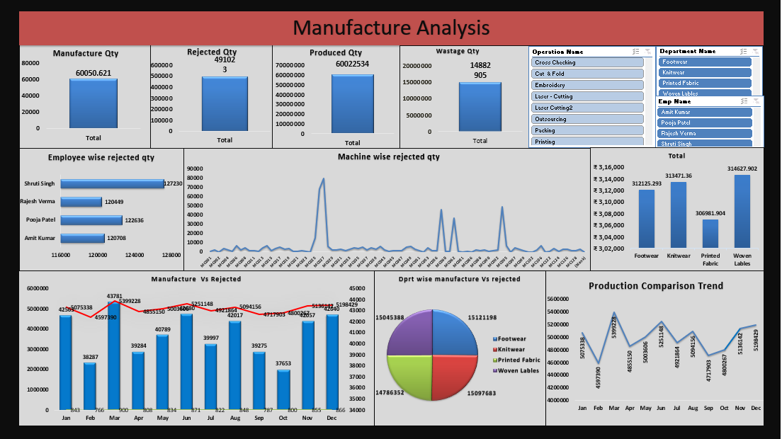
Excel Dashboard

Slide 5
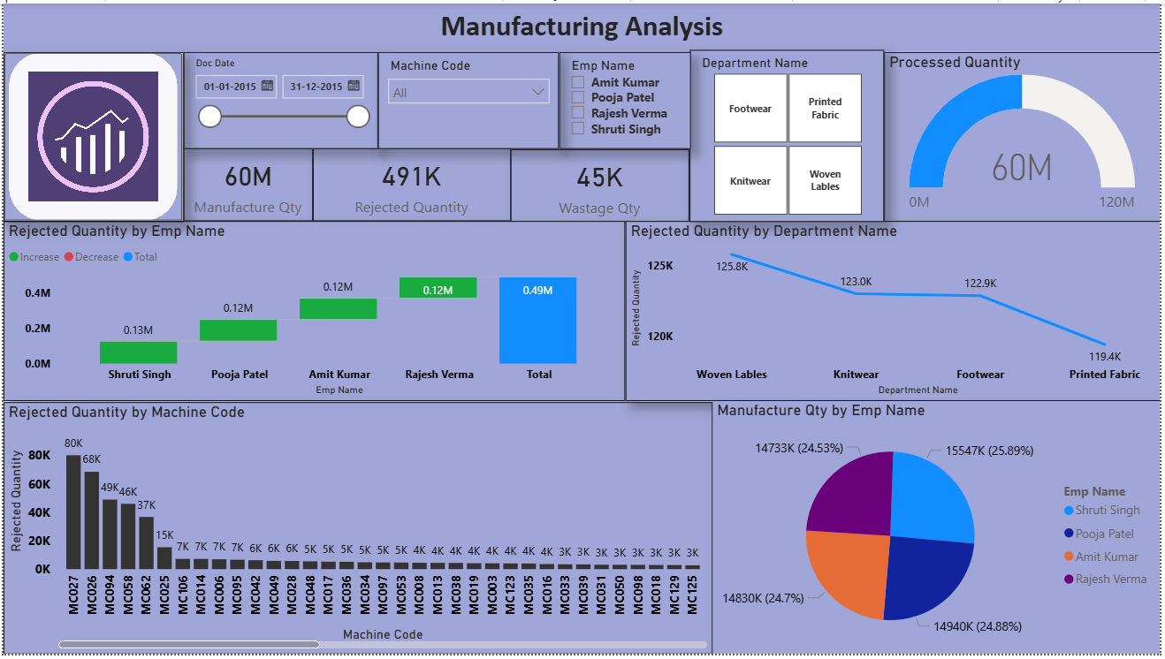
Power BI Dashboard

Slide 6
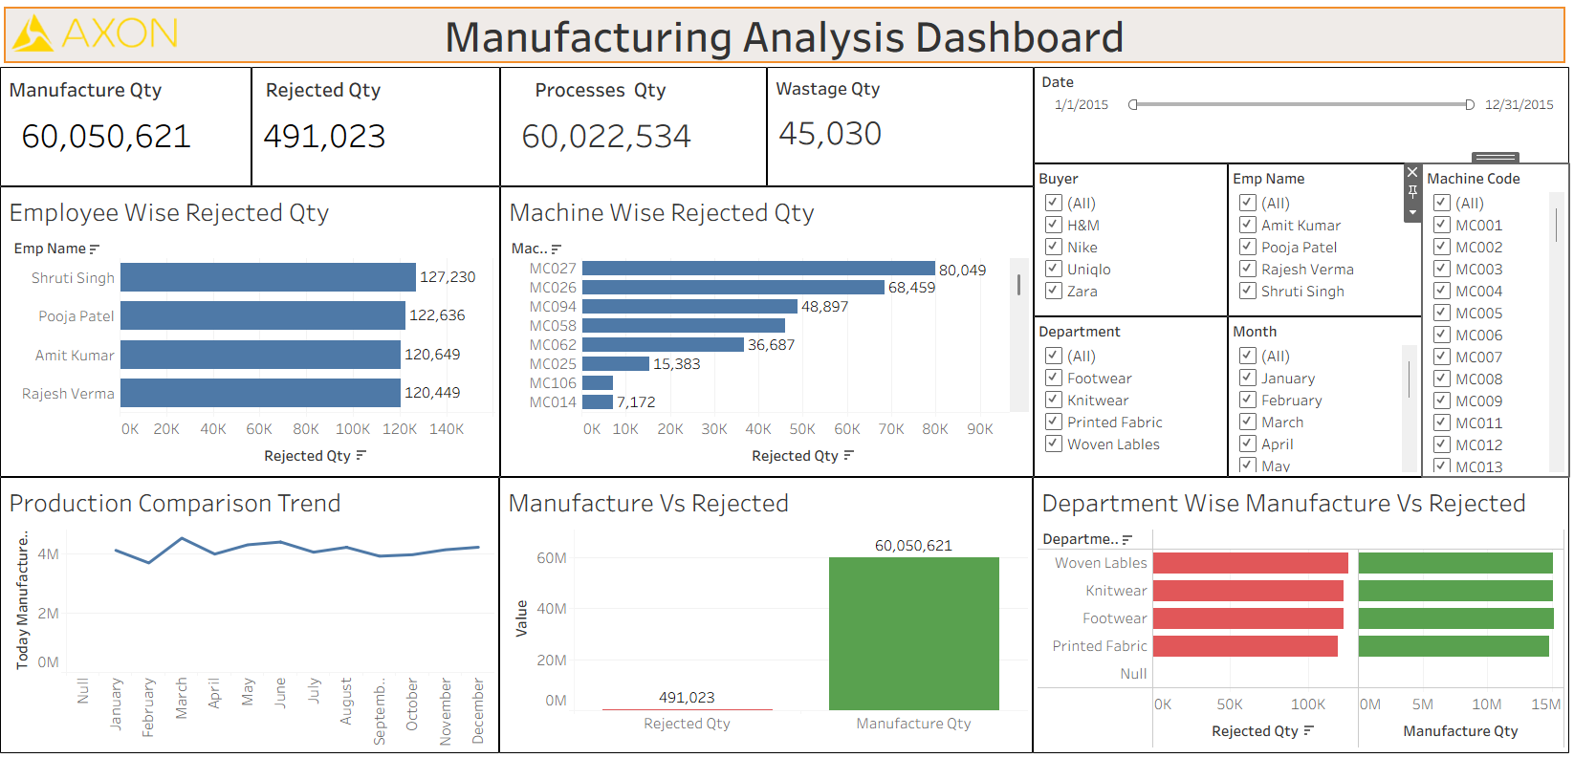
Tableau BI Dashboard

Slide 7
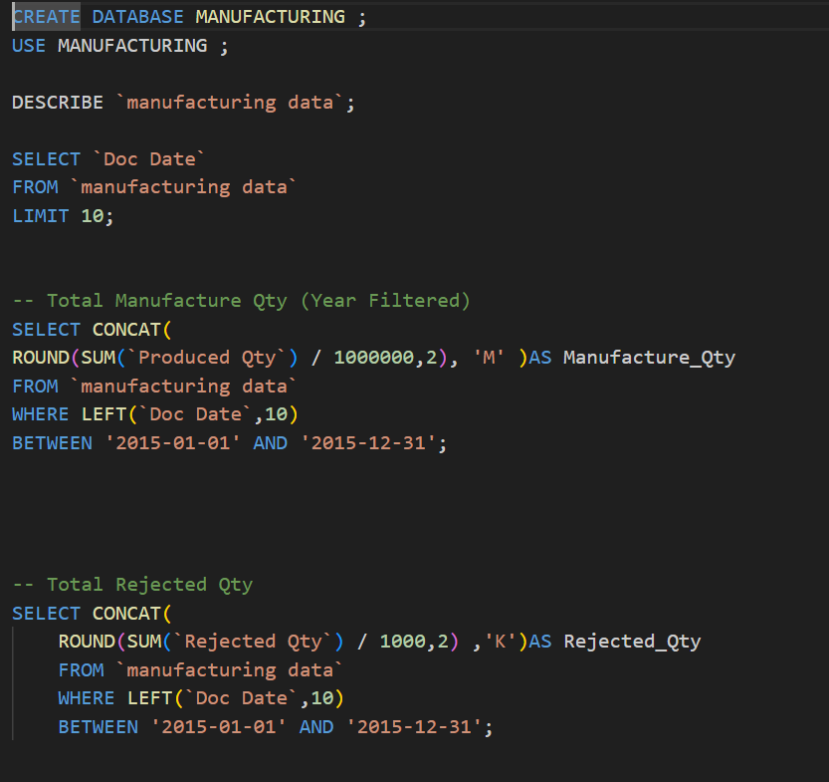
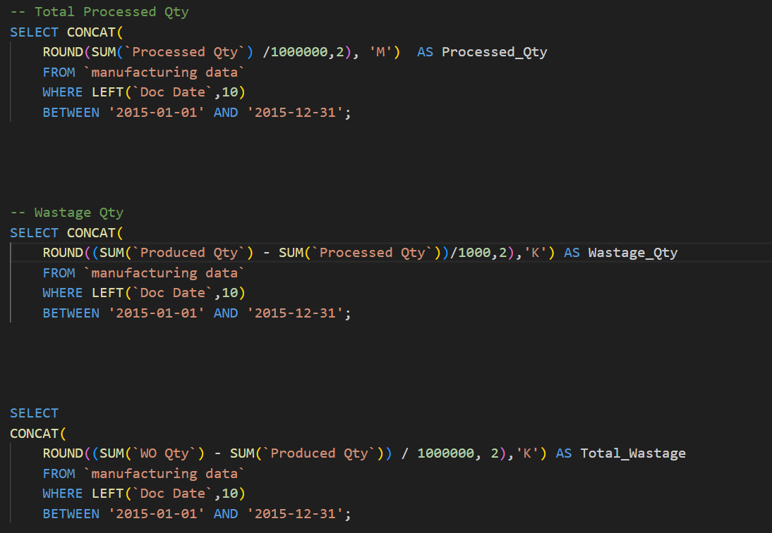
SQL Queries

Slide 8
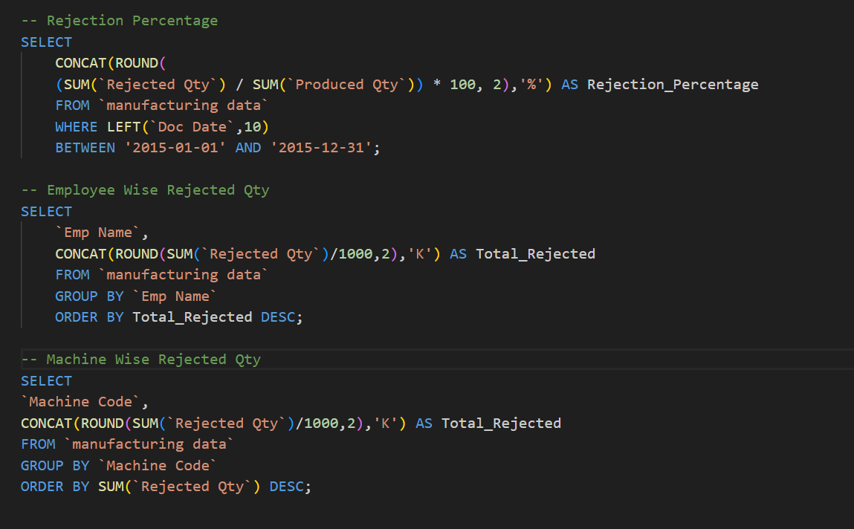
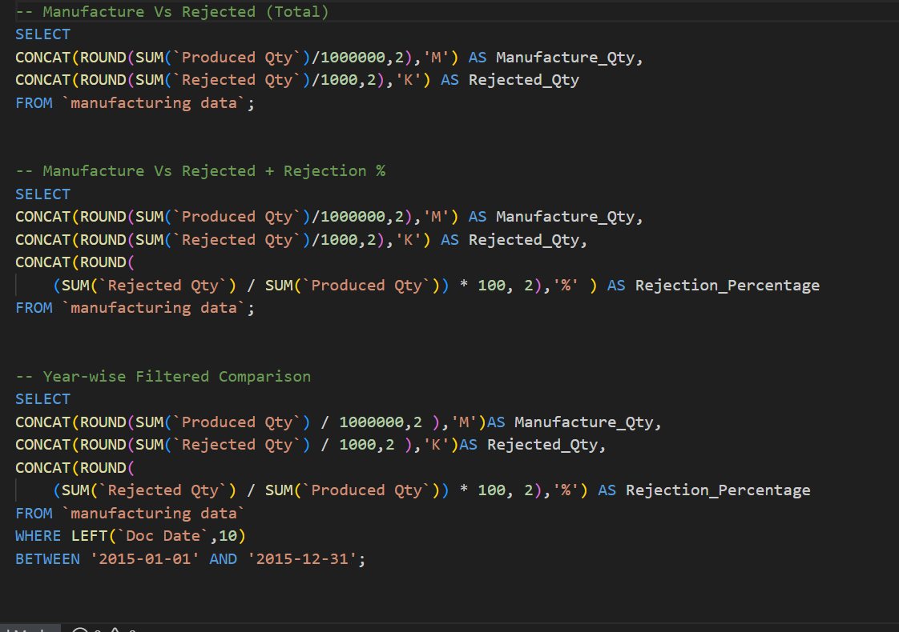
The goal is to

Slide 9
Suggestions for KPI’S
KPI – Manufactured Quantity
Total number of products produced.
Helps measure overall production capacity and productivity.
KPI – Processed Quantity
Total items processed in production.
Helps evaluate production efficiency.
KPI – Rejected Quantity
Number of defective products produced.
Used to monitor product quality.
KPI – Wastage Quantity
Material or products wasted during production.
Helps identify areas to reduce material loss.

Slide 10
Suggestions for KPI’S
KPI –Employee Wise Rejected Quantity
Shows rejected items produced by each employee.
Helps identify training needs and skill gaps.
KPI – Production Comparison Trend
Compares manufacturing, processed, and rejected quantities over time.
Helps identify trends in production performance.
KPI – Machine Wise Rejected Quantity
Shows defect count generated by each machine.
Helps detect machine issues or maintenance needs.
KPI – Manufacture vs Rejected
Compares successful production vs defective items.
Helps evaluate product quality rate.

Slide 11
Conclusion
Manufacturing data analysis helps monitor production performance and product quality.
KPI analysis such as manufactured quantity, rejected quantity, and wastage helps identify inefficiencies.
Machine-wise and employee-wise analysis helps detect defect sources.
Production trend analysis supports better planning and decision making.
Overall, data-driven insights help improve productivity and reduce wastage.

Slide 12


